Slide 1

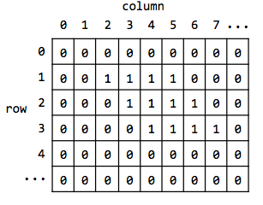
Introduction to Computer Science
IDC Herzliya
Workshop 5
Two-Dimensional Arrays
Notes:
‹#›

Slide 2
Today
2D Arrays
Hands-on

Slide 3
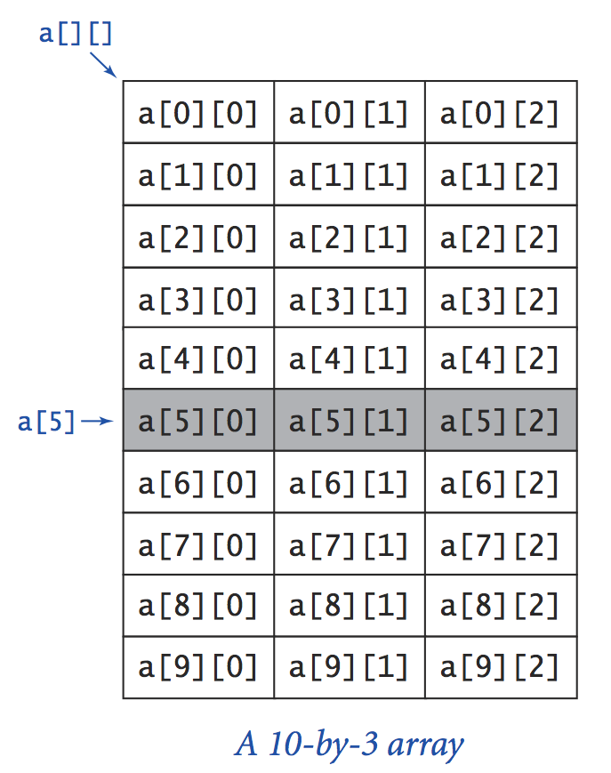
Two dimensional arrays
Two abstract ways to think about a 2D array:
A “table” with “rows” and “columns”
An array of arrays
“Row” a[i] is a 1D array whose elements are:
a[i][0], a[i][1], a[i][2]
Conventions:
Row and column indexes start at 0
The a(i,j) element is accessed by: a[i][j]
Number of elements in row i: a[i].length
Number of rows: a.length

Slide 4
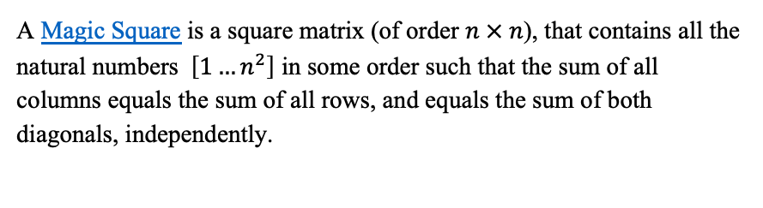
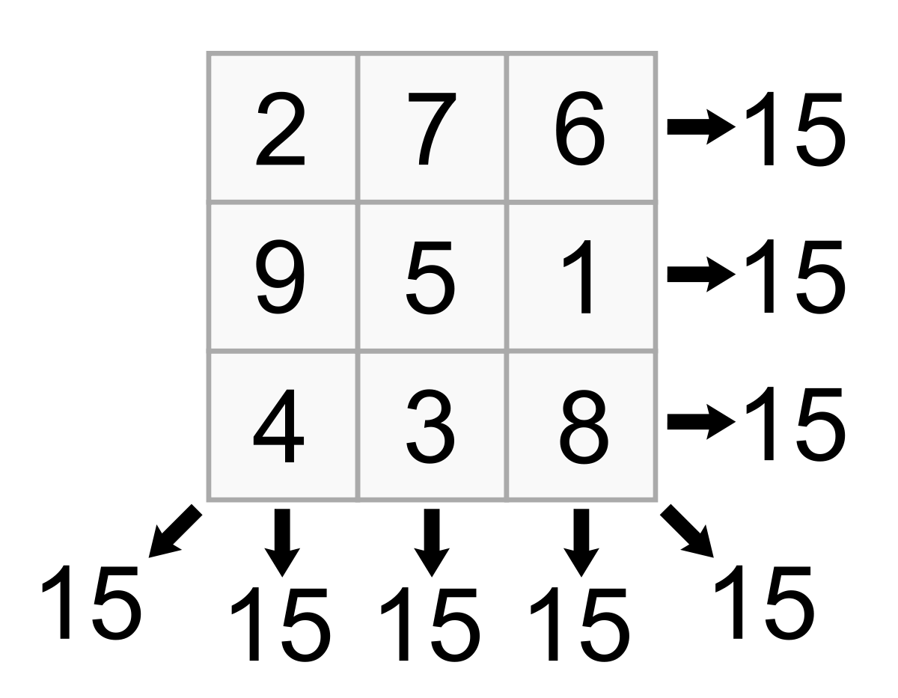
Exercise 1.1
Sum of each row
Sum of each diagonal
Sum of each column

Slide 5
Exercise 1.1 - Our Approach
public class MagicSquare {
// return sum of all numbers in row row
private static int sumRow(int[][] matrix, int row);
// return sum of all numbers in column col
private static int sumCol(int[][] matrix, int col);
// return sum of all numbers in the main diagonal
private static int sumMainDiagonal(int[][] matrix);
// return sum of all numbers in the secondary diagonal
private static int sumSecondaryDiagonal(int[][] matrix);
}

Slide 6

Let’s Code!

Slide 7
Magic Number
Important fact: The “Magic Number” that is supposed to be equal in all functions can be also calculated directly.
Q: How?

Slide 8
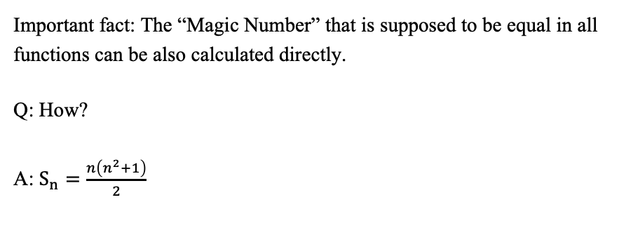

Magic Number

Slide 9
Exercise 1.2 - Our Approach
public class MagicSquare {
// return the magic number
private static int calcMagicNumber(int n);
// return true if a matrix is a magic square or false otherwise
private static boolean isMagicSquare(int[][] matrix);
}

Slide 10

Break time! Be back in 10 mins

Slide 11
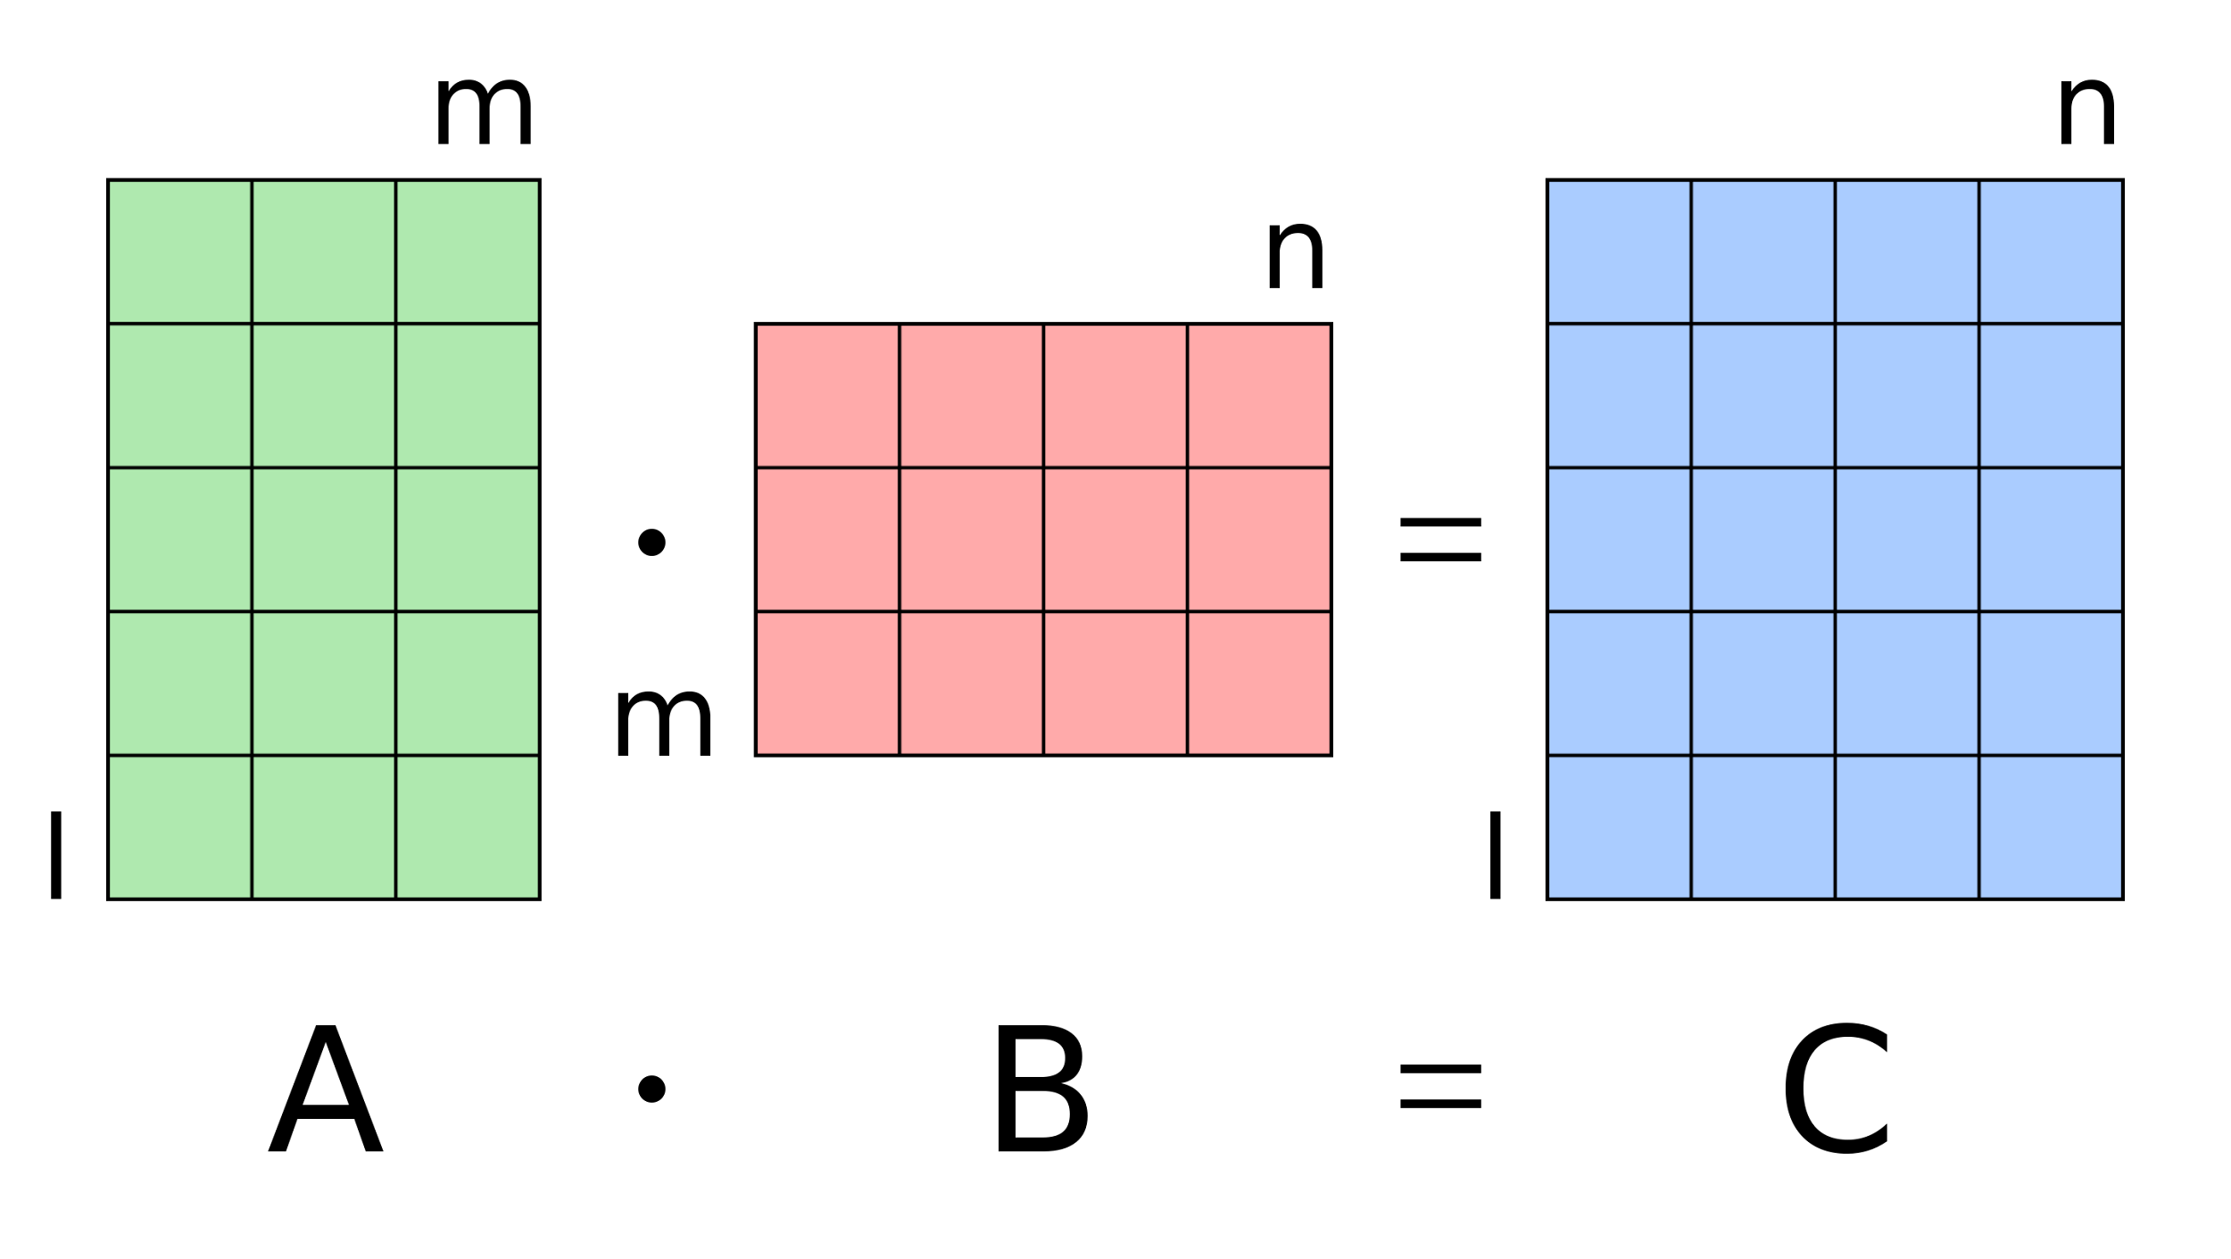
Exercise 2 - Matrix operations: multiplication (wikipedia)
The number of columns in the left matrix must equal the number of rows in the right matrix.
The result matrix has the number of rows of the first and the number of columns of the second matrix.

Slide 12
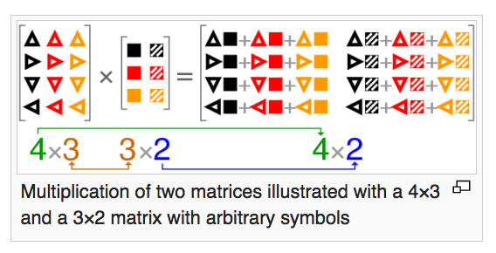
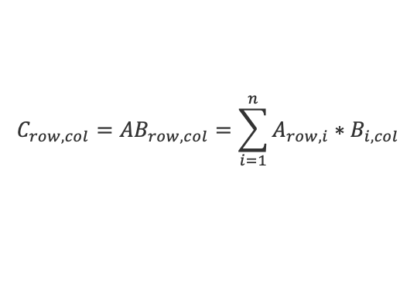
Exercise 2 - Matrix operations: multiplication (wikipedia)

Slide 13
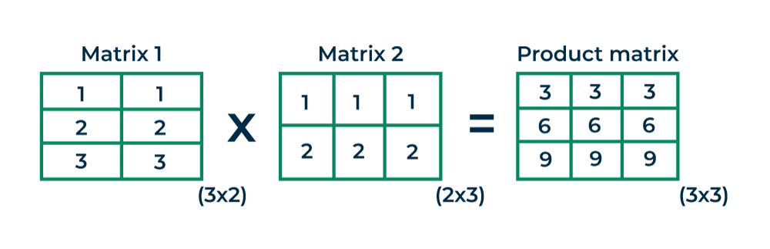

Slide 14
Matrix operations
public class MatrixOps {
public static void main(String args[]) {
…
}
// Returns the addition of the two matrices. Assumes that they have the same dimensions.
private static int[][] add(int[][] m1, int[][] m2) {
…
}
// Returns the multiplication of the two matrices. Assumes that they have compatible dimensions.
private static int[][] mult(int[][] m1, int[][] m2) {
// Put your code here
}
}

Slide 15

Q&A

